Slide 1
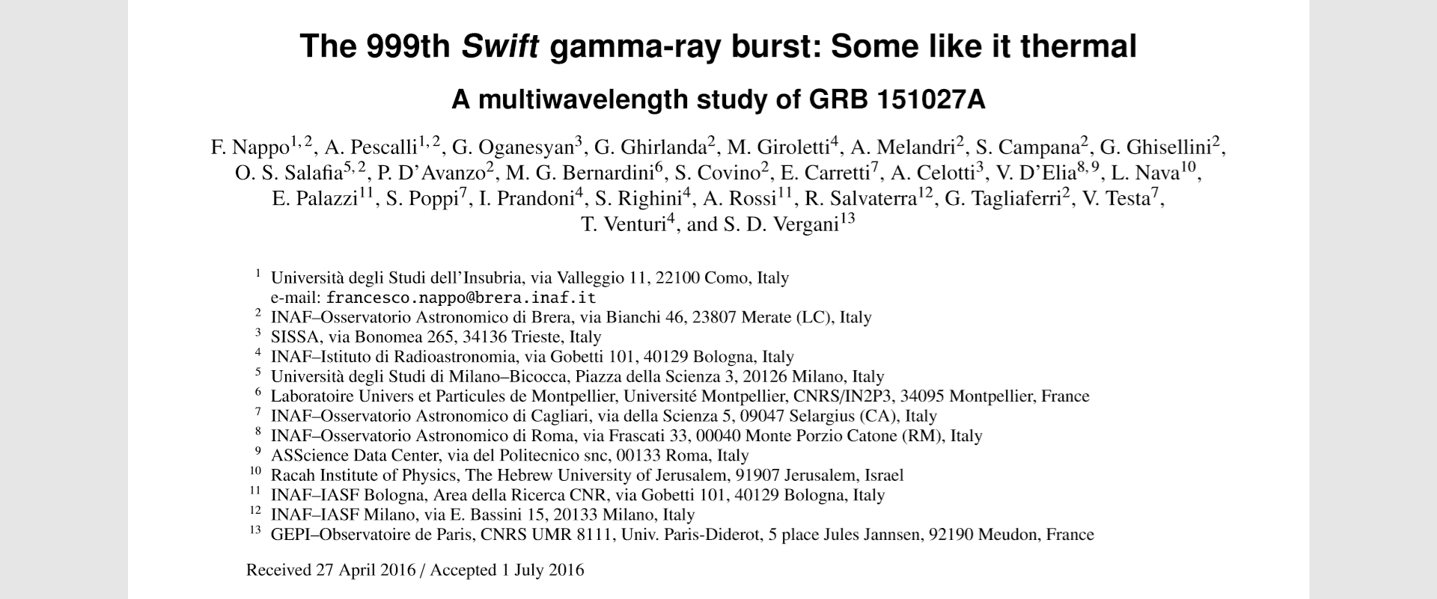
2020.03.13

Slide 2
1.Multiwavelength observations(data)
Fermi-GBM
Gamma-ray and X-ray band
Swift-BAT & XRT
XMM-Newton
Swift-UVOT
optical band
TNG
LBT
VLBI(EVN)
VLBA
Radio band
Medicina
SRT

Slide 3
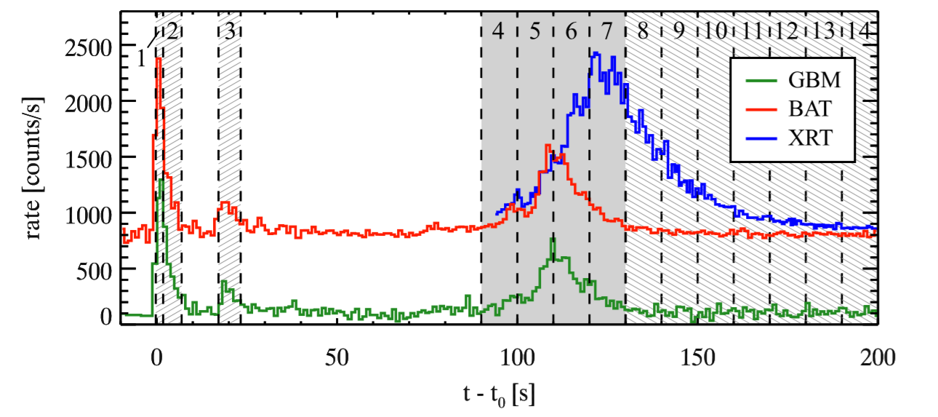
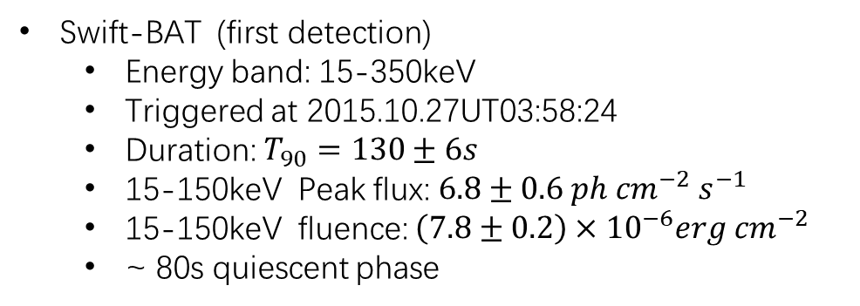
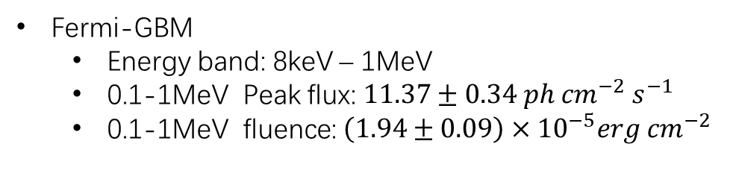
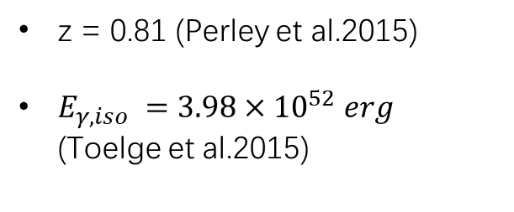
1.1 Gamma-ray and X-ray data
Swift-BAT (first detection)
Energy band: 15-350keV
Triggered at 2015.10.27UT03:58:24
Duration: $T_{90}=130±6s$
15-150keV Peak flux: $6.8±0.6 ph {cm}^{−2} s^{−1}$
15-150keV fluence: $\left(7.8±0.2\right)×{10}^{−6}erg {cm}^{−2}$
~ 80s quiescent phase
Fermi-GBM
Energy band: 8keV – 1MeV
0.1-1MeV Peak flux: $11.37±0.34 ph {cm}^{−2} s^{−1}$
0.1-1MeV fluence: $\left(1.94±0.09\right)×{10}^{−5}erg {cm}^{−2}$
XMM-Newton （approved observations, spectroscopic?）
Mos & pn
21.3 h post trigger and lasting 51.5 ks (~14.3 h)
Swift-XRT
Energy band: 0.3-10keV
87 s post trigger
Shows a delayed bright flare
z = 0.81 (Perley et al.2015)
$E_{γ,iso} =3.98×{10}^{52} erg$ (Toelge et al.2015)

Slide 4
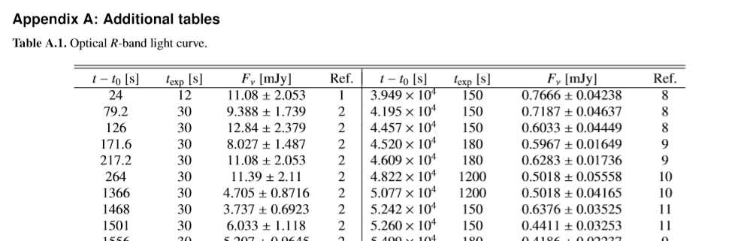
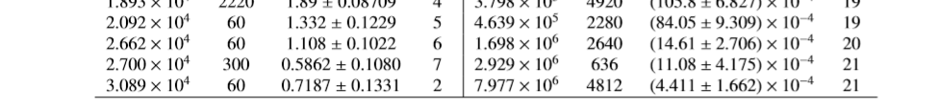
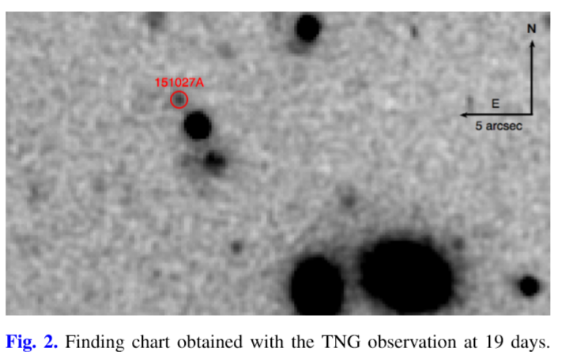
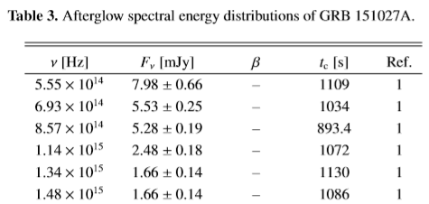
1.2 Optical data
The RAPTOR network of robotic optical telescopes first started optical observation
All the R ( λ=658 nm) magnitudes reported in GCN were collected (for modelling) (table A.1)
Swift-UVOT
Detection in all photometric filters
95 s post trigger (table 3)
TNG late time observations
the Italian 3.6m Telescopio Nazionale Galileo
R filter, total exposure of 44 min
Starting 19.6 days after trigger
LBT late time observations
the 8.4 m Large Binocular Telescope
SDSS-r filter
33.9 and 92.3 days after trigger
exposure time: 20 and 70 min, respectively
…
TNG
LBT

Slide 5
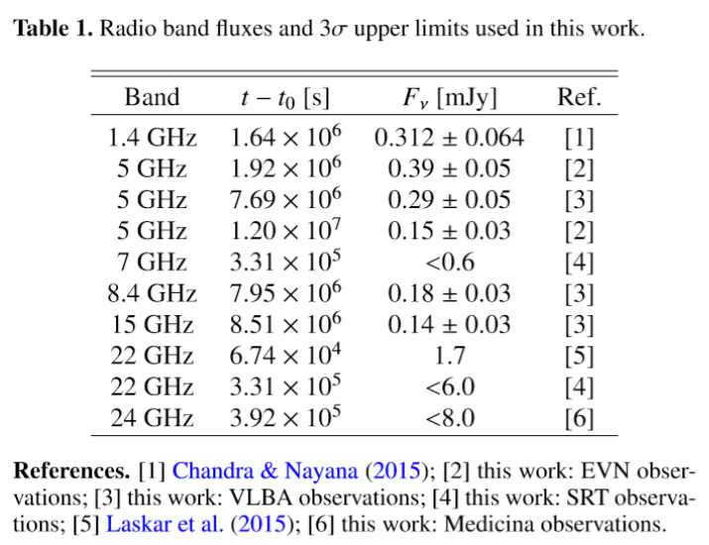
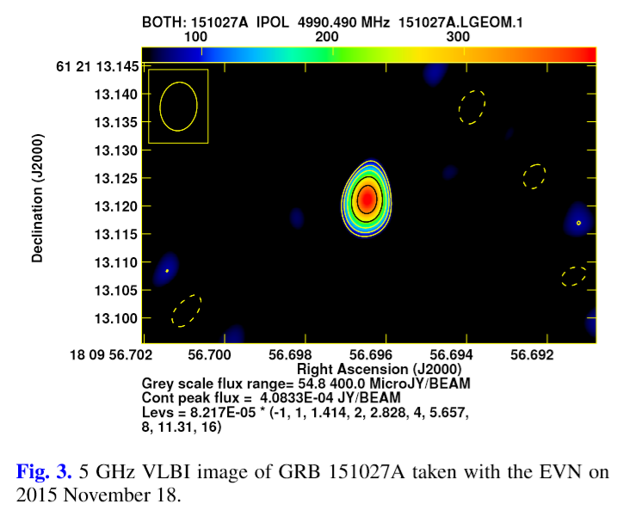
1.3 Radio data
VLA was firstly triggered for radio observations
~ 21.8 GHz, 0.78 days after trigger
Revealing a source with ~ 1.7 mJy
European VLBI (EVN) observations
Centered at 4.98 GHz
15.11.18 and 16.03. 15
Peak brightness: (400±50) and (125±10) μJy/beam, respectively
VLBA observations
2016 01.24, 01.30, and 02.06.
5, 8, and 15 GHz, respectively
At 5 and 8 GHz, A compact source was showed at the image
Medicina observations (approved proposal)
Centered at 24.5 GHz, 2015.10.31
Total on-source time: 27min
No significant emission was detected
Sardinia Rdio Telescope (SRT) observations
No siginificant emission was detected

Slide 6
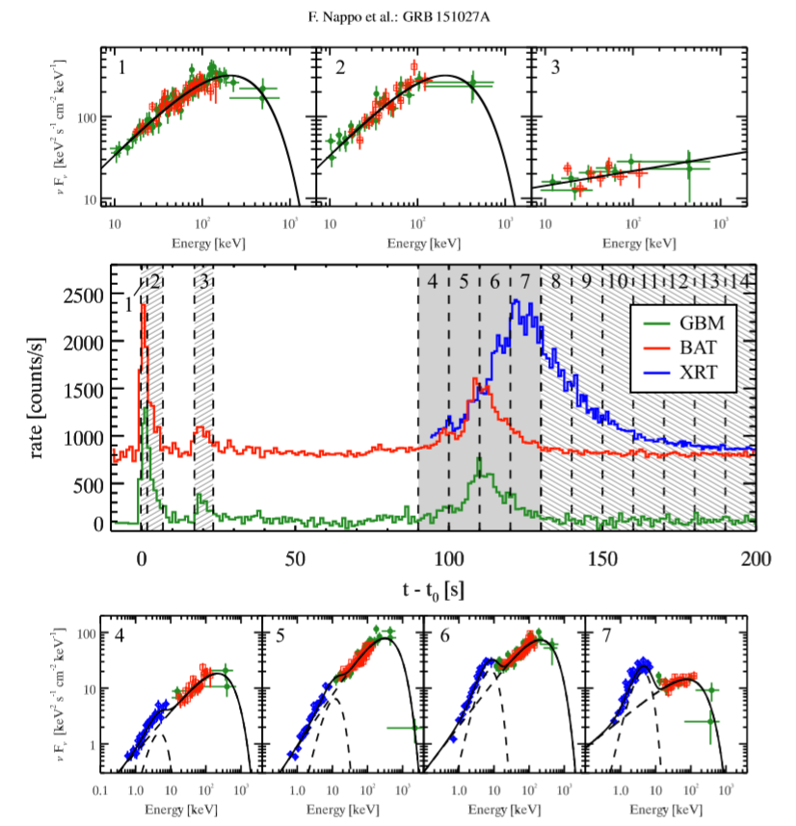
2.Data analysis and results
Prompt emission: first and second peaks
Evidence of a thermal component: third peak
X-ray emission in the interval 130–200 s
XMM-Newton late time spectrum
Radio
Afterglow light curve and spectral energy distributions

Slide 7
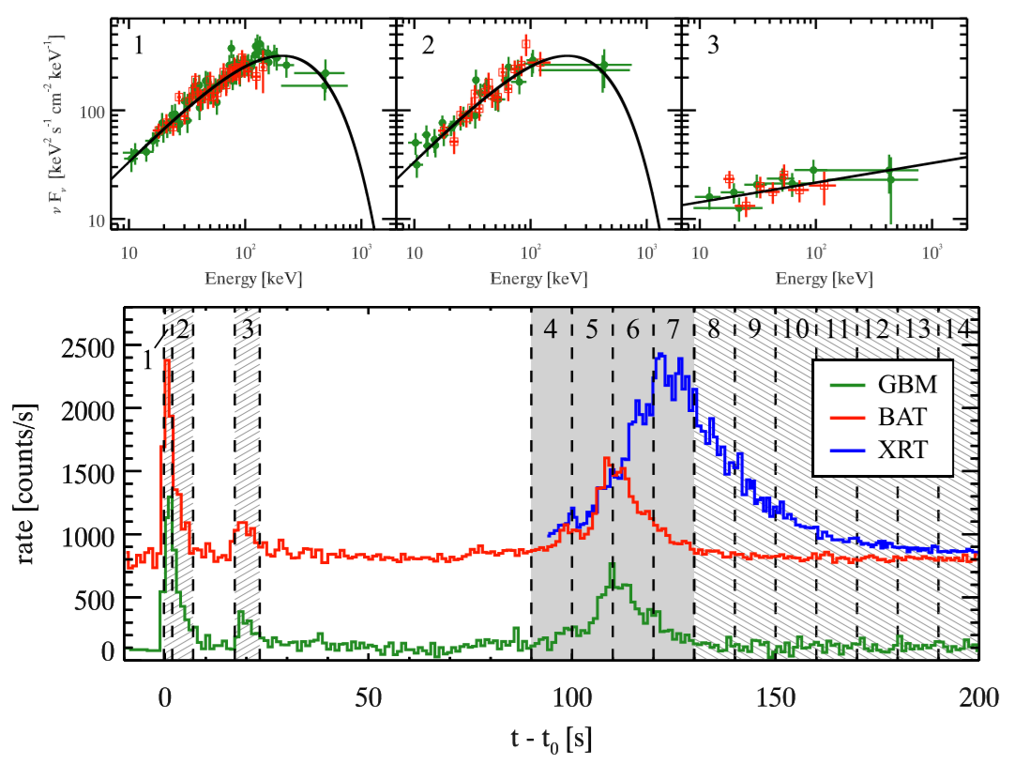
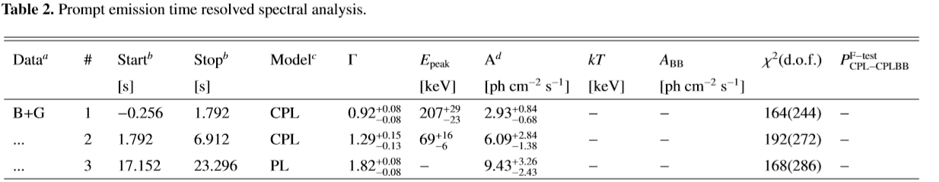
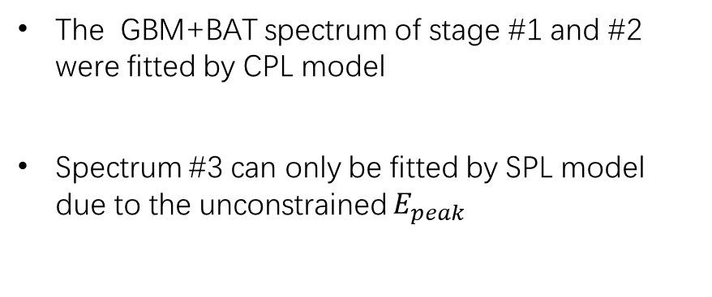
2.1 Prompt emission: first and second peaks
The GBM+BAT spectrum of stage #1 and #2 were fitted by CPL model
Spectrum #3 can only be fitted by SPL model due to the unconstrained $E_{peak}$

Slide 8
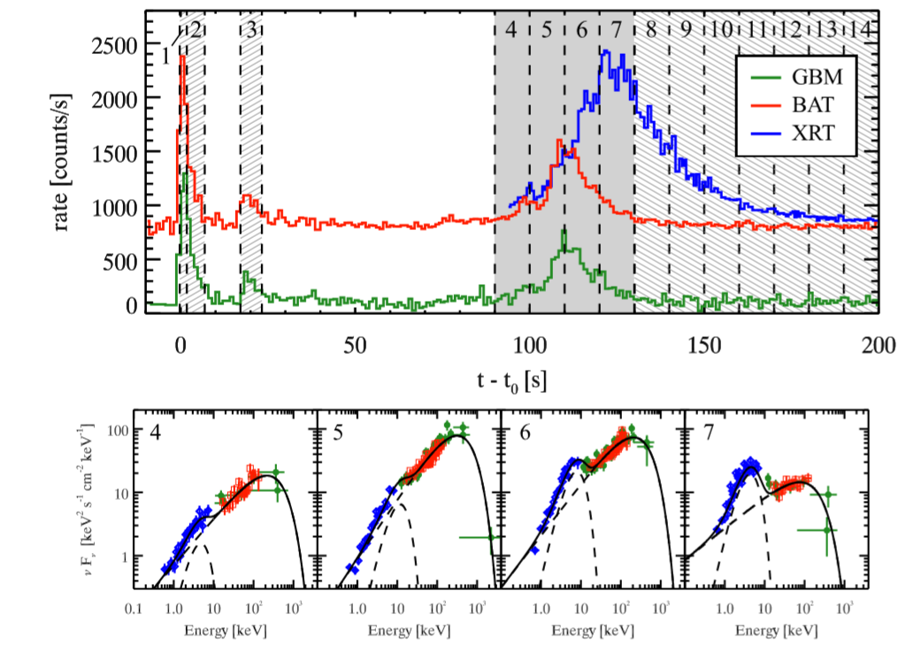
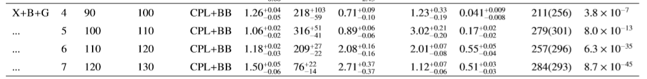
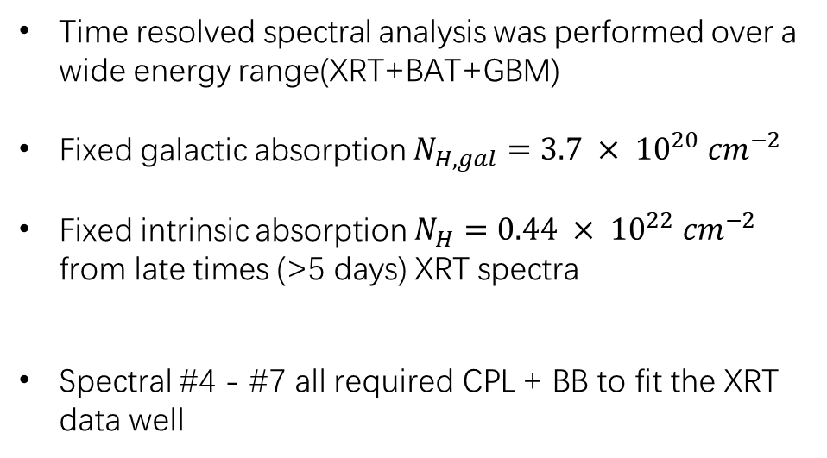
2.2 Evidence of a thermal component: third peak
Time resolved spectral analysis was performed over a wide energy range(XRT+BAT+GBM)
Fixed galactic absorption $N_{H,gal}=3.7 × {10}^{20} {cm}^{−2}$
Fixed intrinsic absorption $N_{H}=0.44 × {10}^{22} {cm}^{−2}$ from late times (>5 days) XRT spectra
Spectral #4 - #7 all required CPL + BB to fit the XRT data well

Slide 9
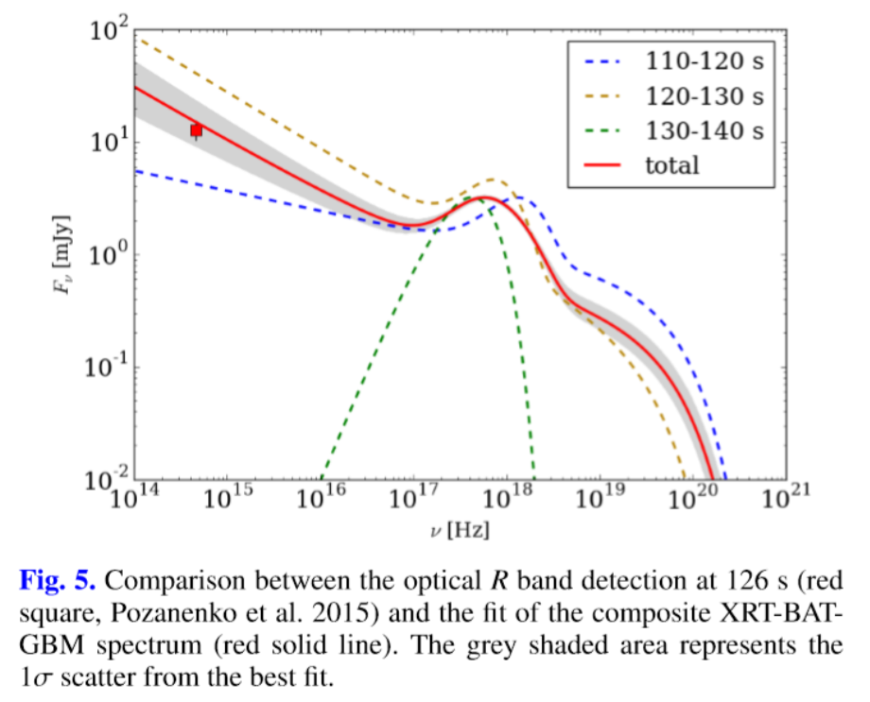
2.3 X-ray emission in the interval 130–200 s
The early optical emission could have the same origin with the high energy emission.

Slide 10
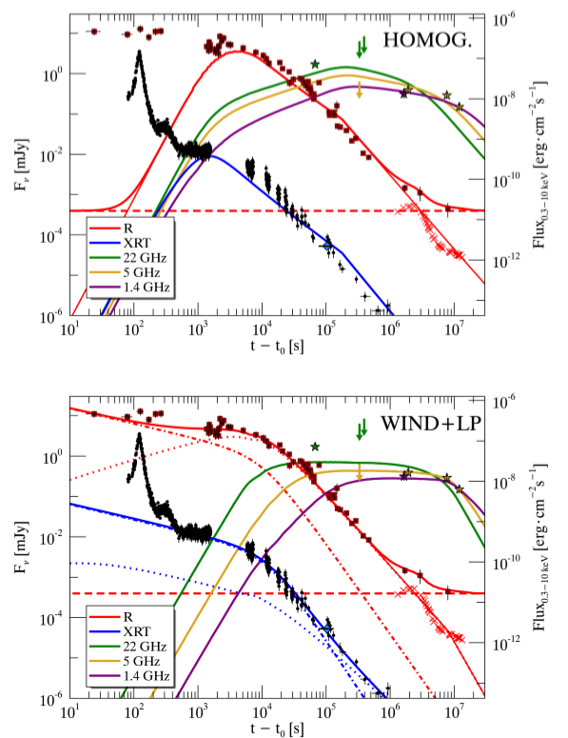
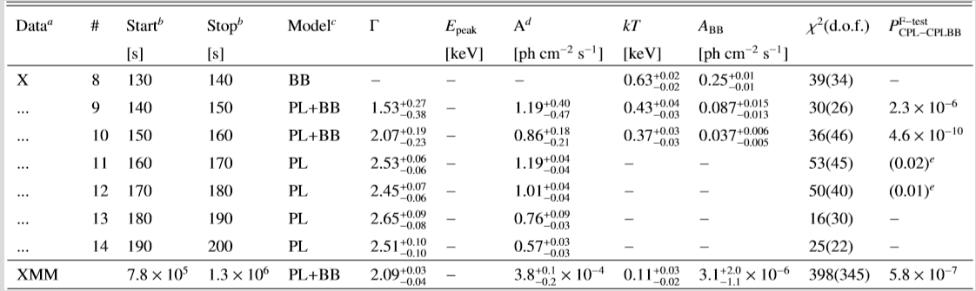
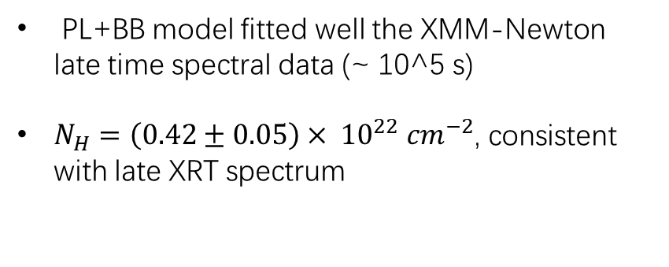
2.4 XMM-Newton late time spectrum
PL+BB model fitted well the XMM-Newton late time spectral data (~ 10^5 s)
$N_{H}=\left(0.42±0.05\right)× {10}^{22} {cm}^{−2}$, consistent with late XRT spectrum

Slide 11
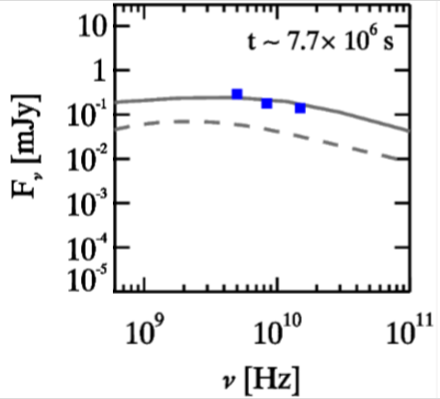
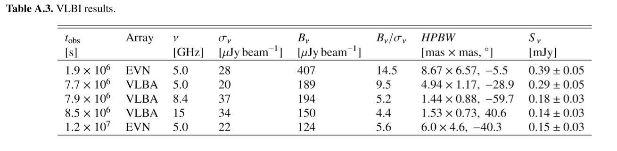
2.5 Radio
From EVN and VLBA 5 GHz data:
the source flux density decreased by ~50% from 22d to 89d, and a further ~50% from 89d to 140d.
From the nealy simultaneous VLBA multi-λ data:
spectral index β = 0.7–0.9

Slide 12
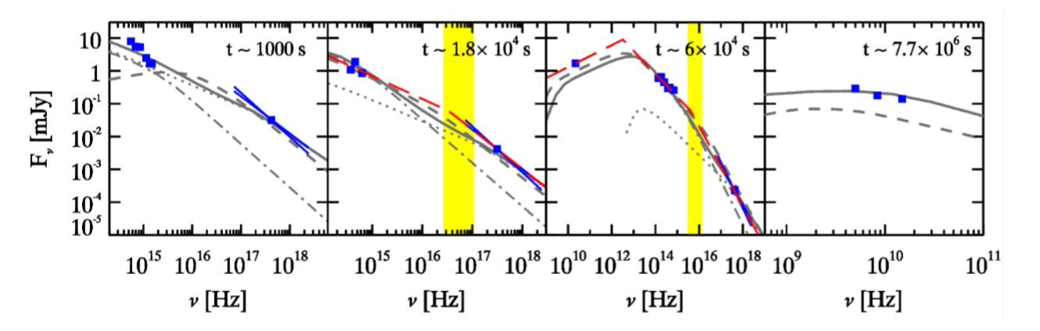
2.6 Afterglow light curve and spectral energy distributions
Multiwavelength light curves of the afterglow of GRB 151027A are built
Four epoches spectral energy distributions are built :
1000 s, 1.8 × 10^4 s, 6 × 10^4 s, 7.7 × 10^6 s

Slide 13
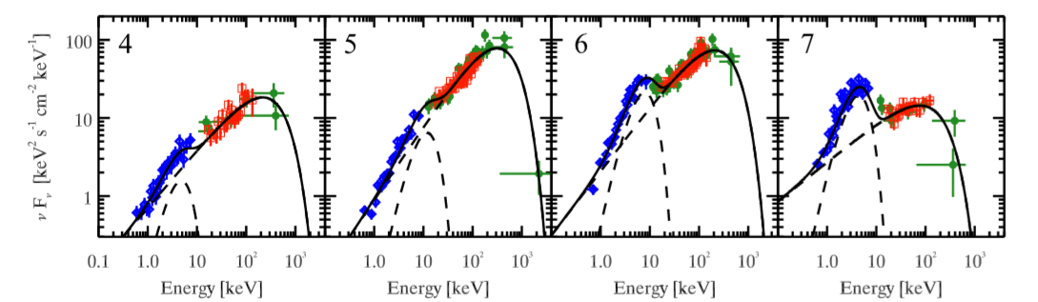
3. Discussion
Prompt emission and flare
‘reborn fireball’ model
Modelling the afterglow
Forward shock + homogeneous CBM
Forward shock + wind CBM
Possible Supernova

Slide 14
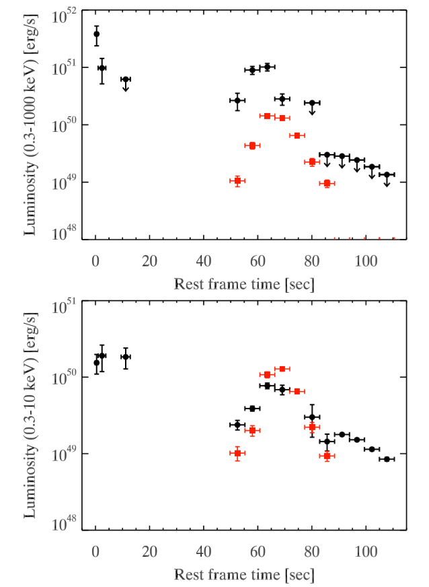
3.1 Prompt emission and flare
The coexisting of a BB and non-thermal component :
The X-ray flare has a very luminous thermal component (~ 10^50 erg/s)
The thermal luminosity peaks later than the non-thermal component
The thermal component contributed to most of the total flux in 0.3-10 keV and to 35% in 0.3-1000keV
The thermal component was still detected by XMM-Newton at late time (10^6 s) spectrum with a luminosity ∼5 × 10^44 erg/s, corresponding to ∼8% of the 0.3–10 keV emission
Discussions are mainly around the BB component

Slide 15
3.1 Prompt emission and flare
The likely origin of the BB component
Ib/c SN?
the typical X-ray luminosity of such emission is of ∼10^45 erg/s, lower than our GRB
the emission of a hot plasma cocoon?
the expected luminosity of this emission is ~10^47 erg/s, again lower than our case

Slide 16
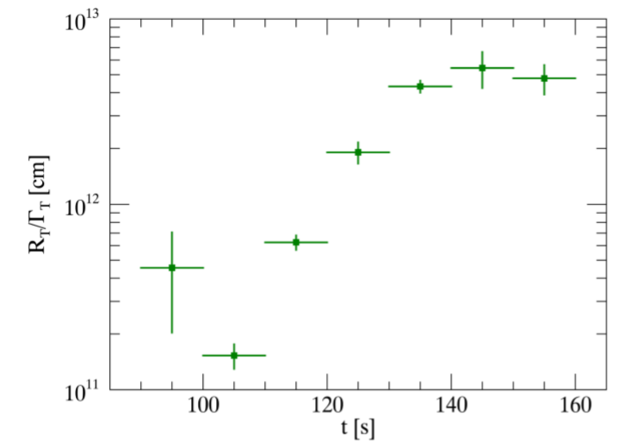
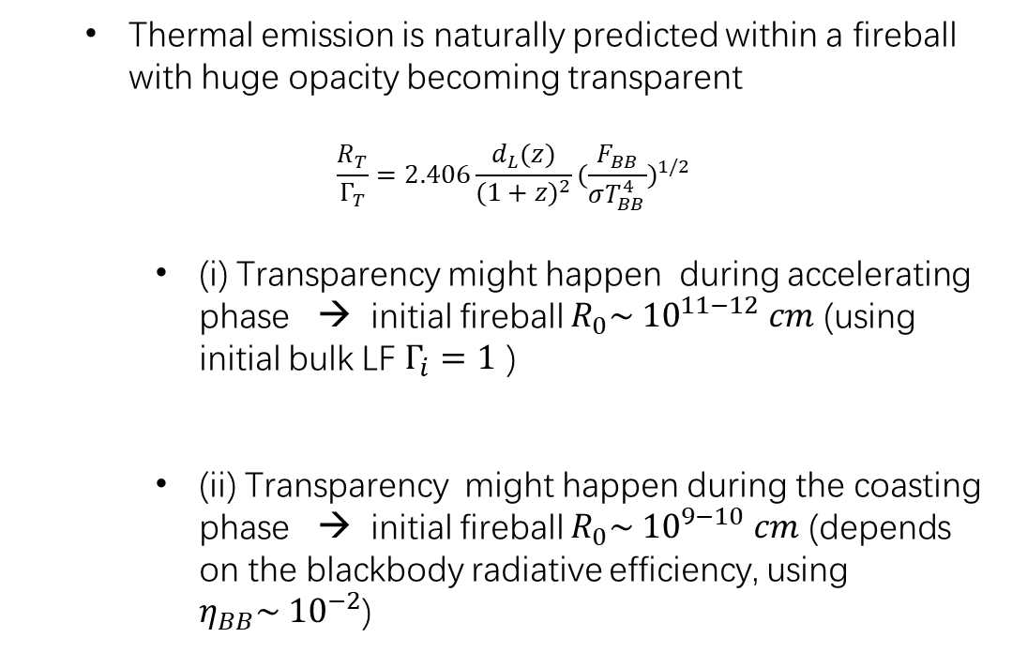
3.1 Prompt emission and flare
Thermal emission is naturally predicted within a fireball with huge opacity becoming transparent
$$\frac{R_{T}}{Γ_{T}}=2.406\frac{d_{L}(z)}{{(1+z)}^{2}}{(\frac{F_{BB}}{σT_{BB}^{4}})}^{1/2}$$
(i) Transparency might happen during accelerating phase → initial fireball $R_{0}\sim {10}^{11−12} cm$ (using initial bulk LF $Γ_{i}=1$ )
(ii) Transparency might happen during the coasting phase → initial fireball $R_{0}\sim {10}^{9−10} cm$ (depends on the blackbody radiative efficiency, using $η_{BB}\sim {10}^{−2}$)

Slide 17
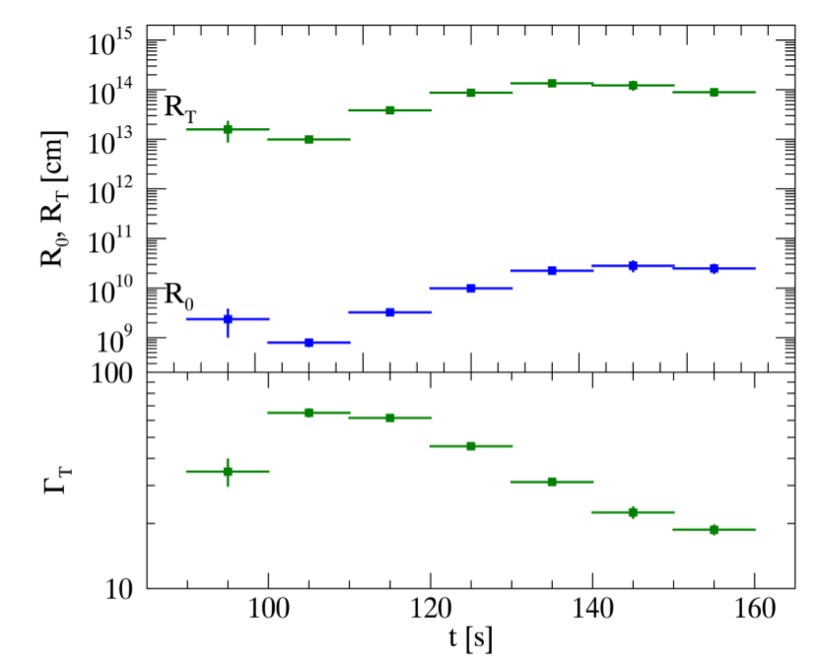
3.1 Prompt emission and flare
Thermal emission is naturally predicted within a fireball with huge opacity becoming transparent
$$\frac{R_{T}}{Γ_{T}}=2.406\frac{d_{L}(z)}{{(1+z)}^{2}}{(\frac{F_{BB}}{σT_{BB}^{4}})}^{1/2}$$
(i) Transparency might happen during accelerating phase → initial fireball $R_{0}\sim {10}^{11−12} cm$ (using initial bulk LF $Γ_{i}=1$ )
(ii) Transparency might happen during the coasting phase → initial fireball $R_{0}\sim {10}^{9−10} cm$ (depends on the blackbody radiative efficiency, using $η_{BB}\sim {10}^{−2}$)
What kind of scenario can reach such a radius for initial fireball?

Slide 18
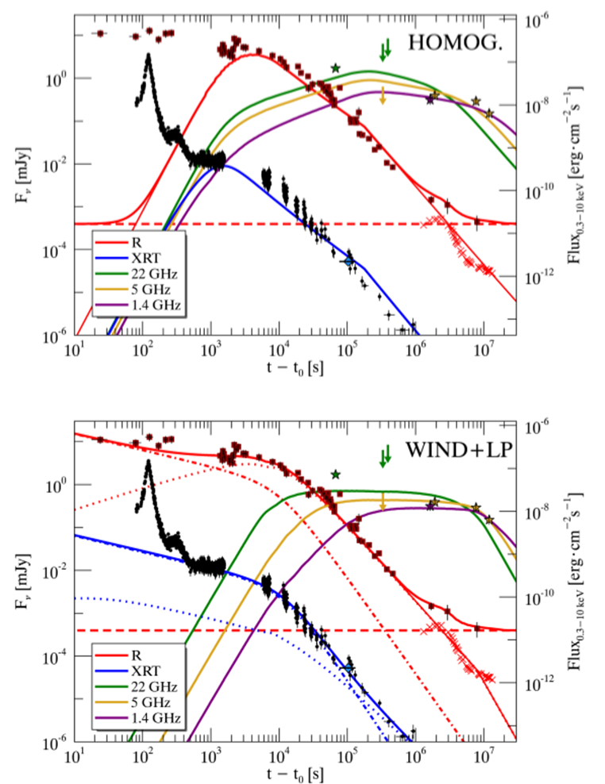
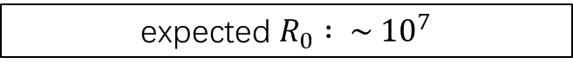
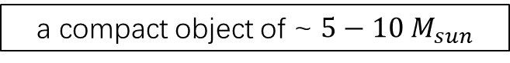
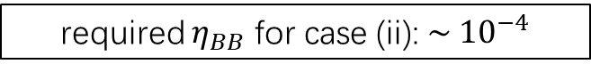
3.1 Prompt emission and flare
If the progenitor is produced from the core collapse scenario of a Wolf-Rayet star:
a compact object of ~ $5−10 M_{sun}$
expected $R_{0} : \sim {10}^{7}$
required $η_{BB}$ for case (ii): $\sim {10}^{−4}$
enormous burst of kinetic energy
energetic afterglow
INCONSISTENT WITH OBSERVATIONS

Slide 19
3.1 Prompt emission and flare
Another explanation: “reborn” fireball model: $R_{0}\sim {10}^{11} cm$
thermal emission by the heated plasma
relativistic ejecta
surrounding material
slower, optical thick
produce initial prompt emission

Slide 20
3.2 Modelling the afterglow （X-ray – radio band, >500s）
Forward shock + homogeneous CBM
Forward shock + wind CBM
Possible Supernova

Slide 21
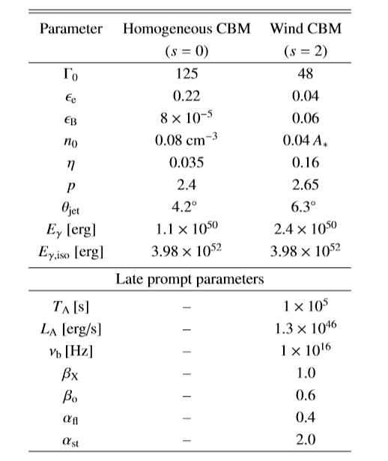
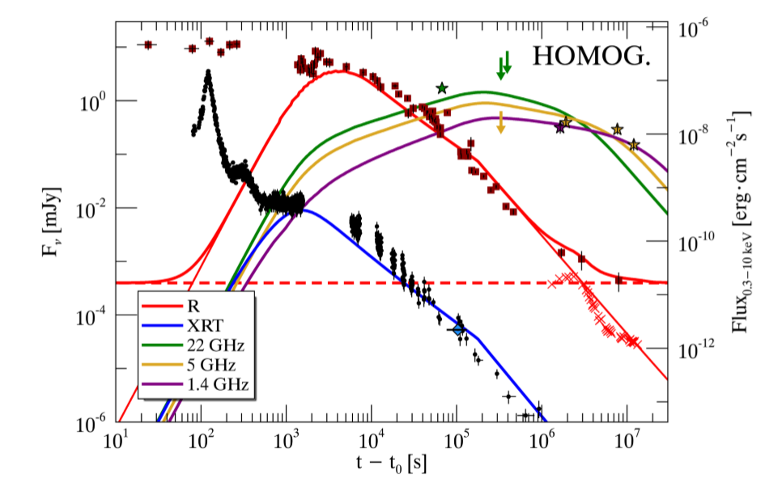
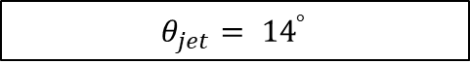
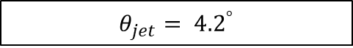
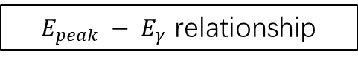
3.2.1 Forward shock + homogeneous CBM
？？？
achromatic break at t ∼ 5.8 × 10^6
$$θ_{jet}= {4.2}^{°}$$
$$θ_{jet}= {14}^{°}$$
a jet break from modelling
$E_{peak} − E_{γ}$ relationship

Slide 22
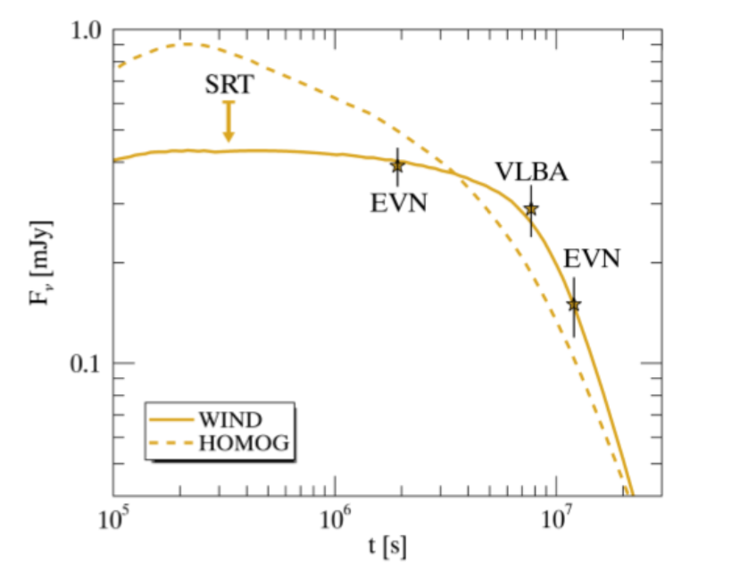
3.2.1 Forward shock + homogeneous CBM
The homogeneous density profile can be excluded.

Slide 23
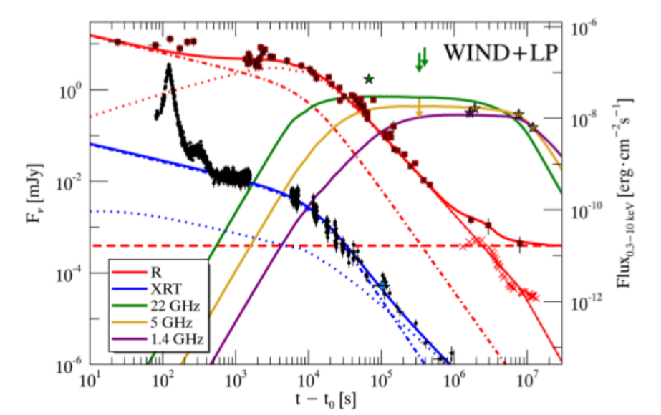
3.2.1 Forward shock + wind CBM
X-ray observations
X-ray flux of FS prediction
X –ray observations are higher than the FS predication
X-ray LC shows plateau and flare

Slide 24
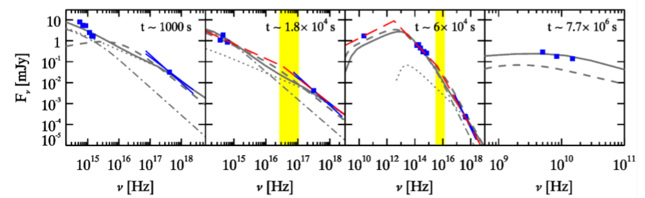
3.2.1 Forward shock + wind CBM
extrapolation of UVOT observations
X-ray flux is much higher than the extrapolation of the power law component of the UVOT emission
X –ray observations are higher than the FS predication
X-ray LC shows plateau and flare
additional origin: late prompt emission

Slide 25
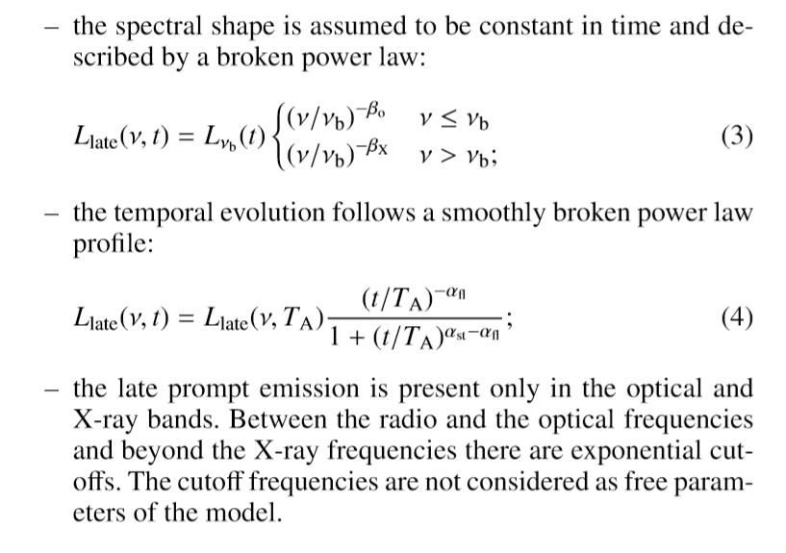
3.2.1 Forward shock + wind CBM + late prompt emission

Slide 26
3.2.1 Forward shock + wind CBM + late prompt emission

Slide 27
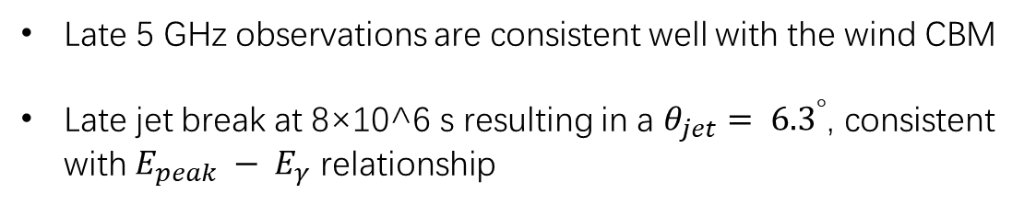
3.2.1 Forward shock + wind CBM + late prompt emission
Late 5 GHz observations are consistent well with the wind CBM
Late jet break at 8×10^6 s resulting in a $θ_{jet}= {6.3}^{°}$, consistent with $E_{peak} − E_{γ}$ relationship

Slide 28
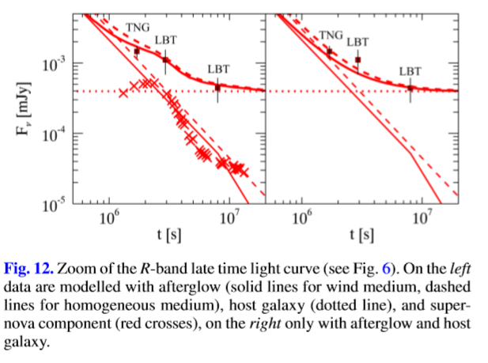
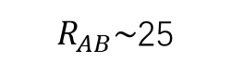
3.3 Possible evidence of SN?
$R_{AB}\sim$25

Slide 29
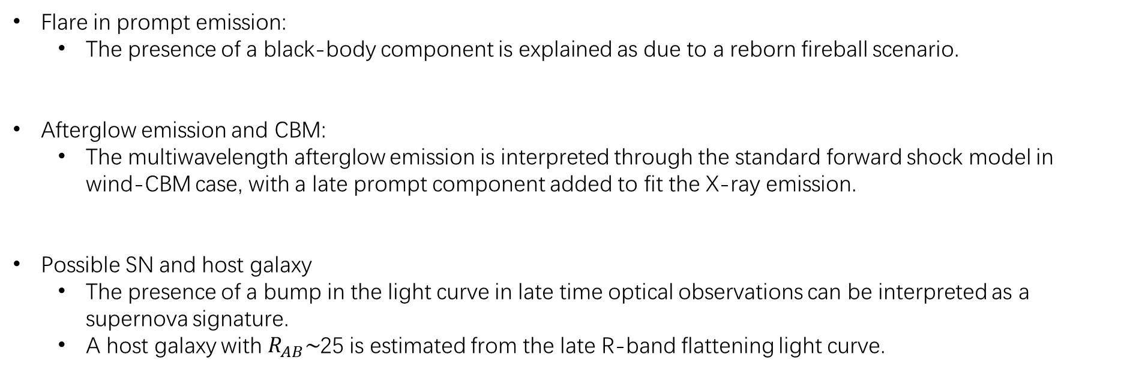
4.Conclusions
Flare in prompt emission:
The presence of a black-body component is explained as due to a reborn fireball scenario.
Afterglow emission and CBM:
The multiwavelength afterglow emission is interpreted through the standard forward shock model in wind-CBM case, with a late prompt component added to fit the X-ray emission.
Possible SN and host galaxy
The presence of a bump in the light curve in late time optical observations can be interpreted as a supernova signature.
A host galaxy with $R_{AB}\sim$25 is estimated from the late R-band flattening light curve.

Slide 30
Thanks for constructing.
2020.03.13

